Slide 1
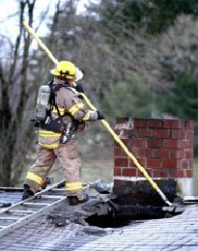
What is the problem here?

Slide 2
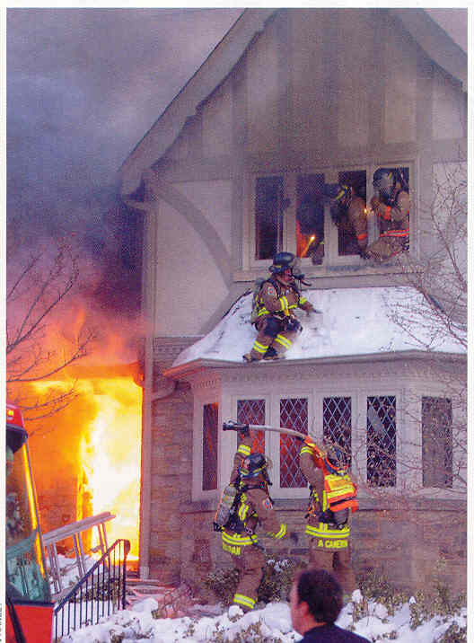
How long will it take to place a ladder NOW?

Slide 3
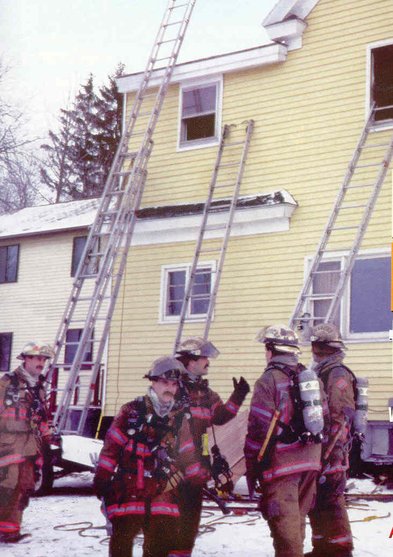
DEPLOY THE LADDERS “Just in case”

Slide 4
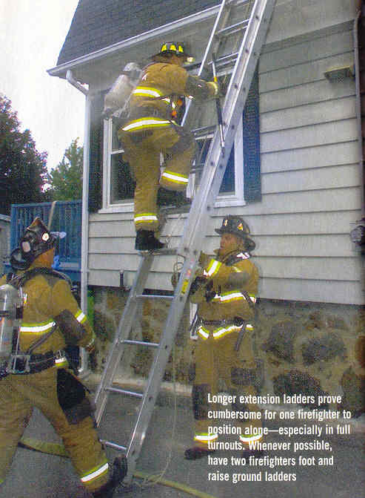

Slide 5
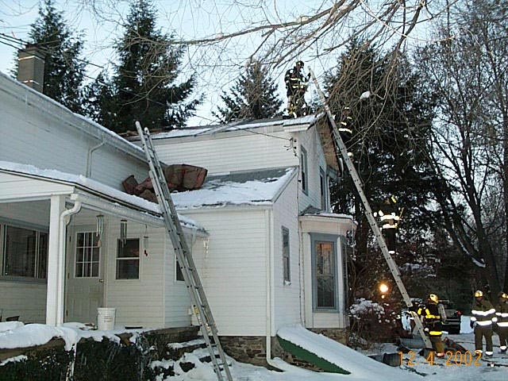
Roof
35’ Ext.
24’ Ext.

Slide 6
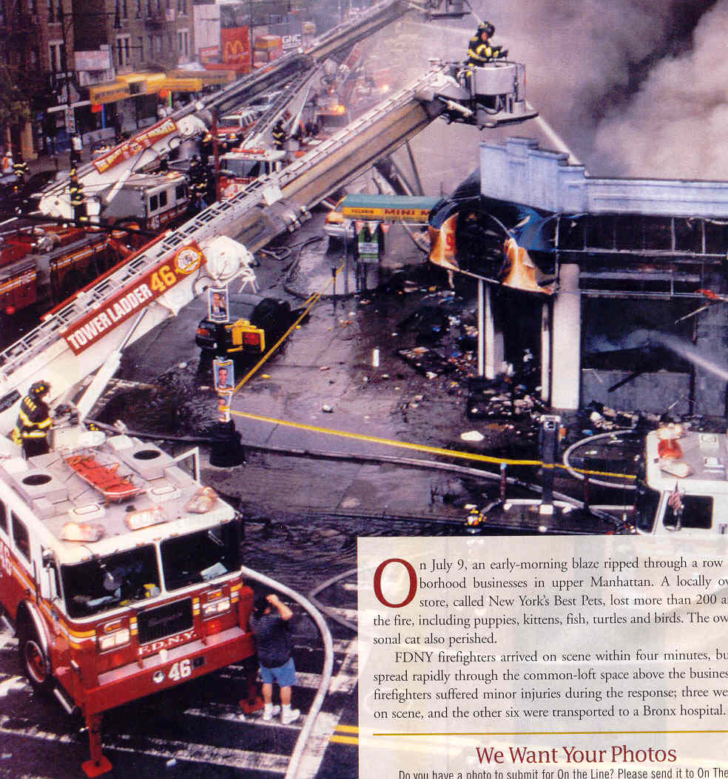
Leave room in front of the structure for the ladder, Park ladder on the corner if possible!

Slide 7
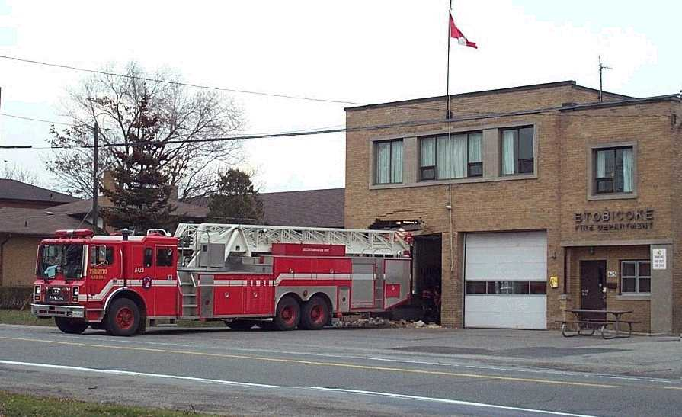
Do you know the size of you rig?

Slide 9
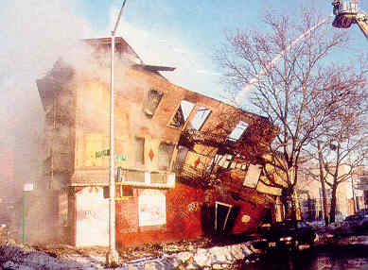
Collapse Considerations

