Slide 1
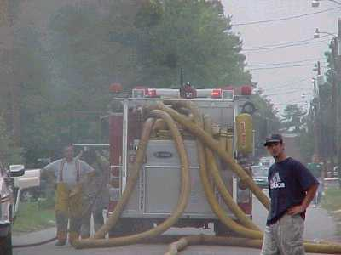
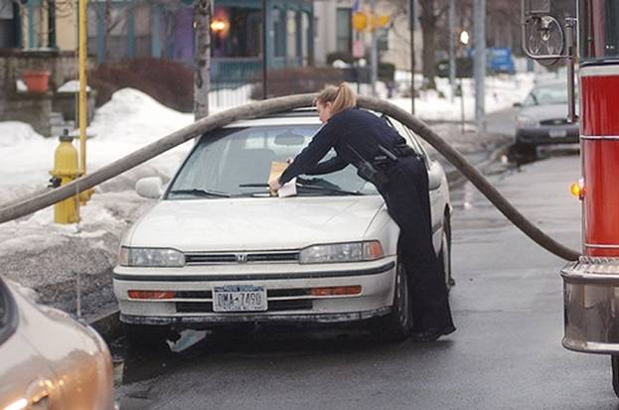
Water Supply

Slide 2
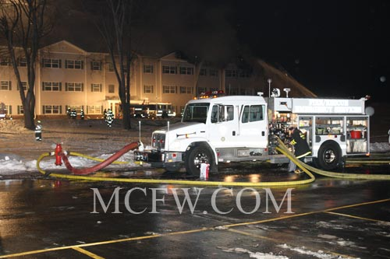
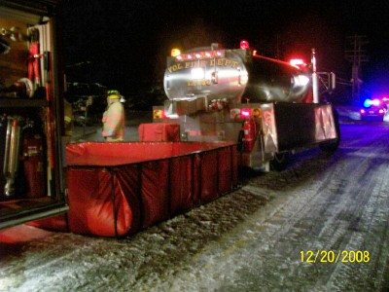
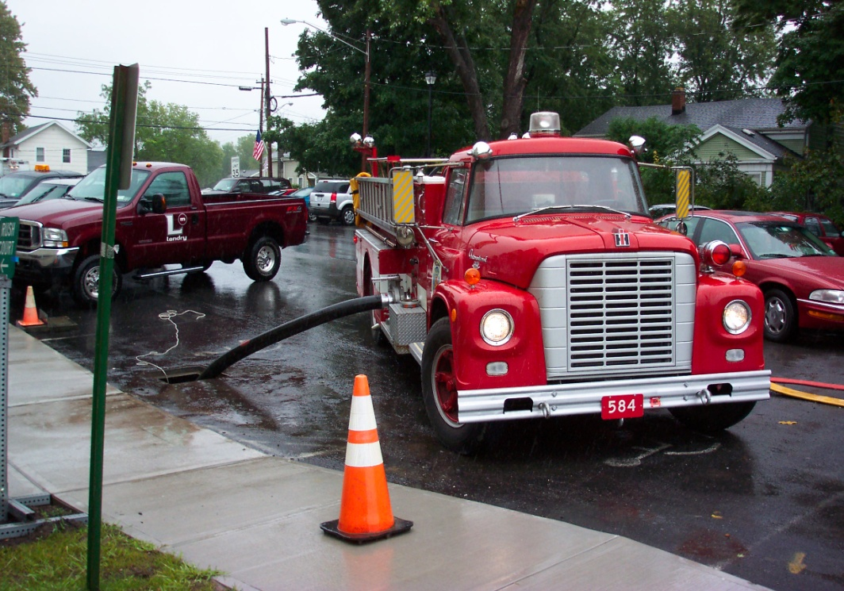

Slide 3
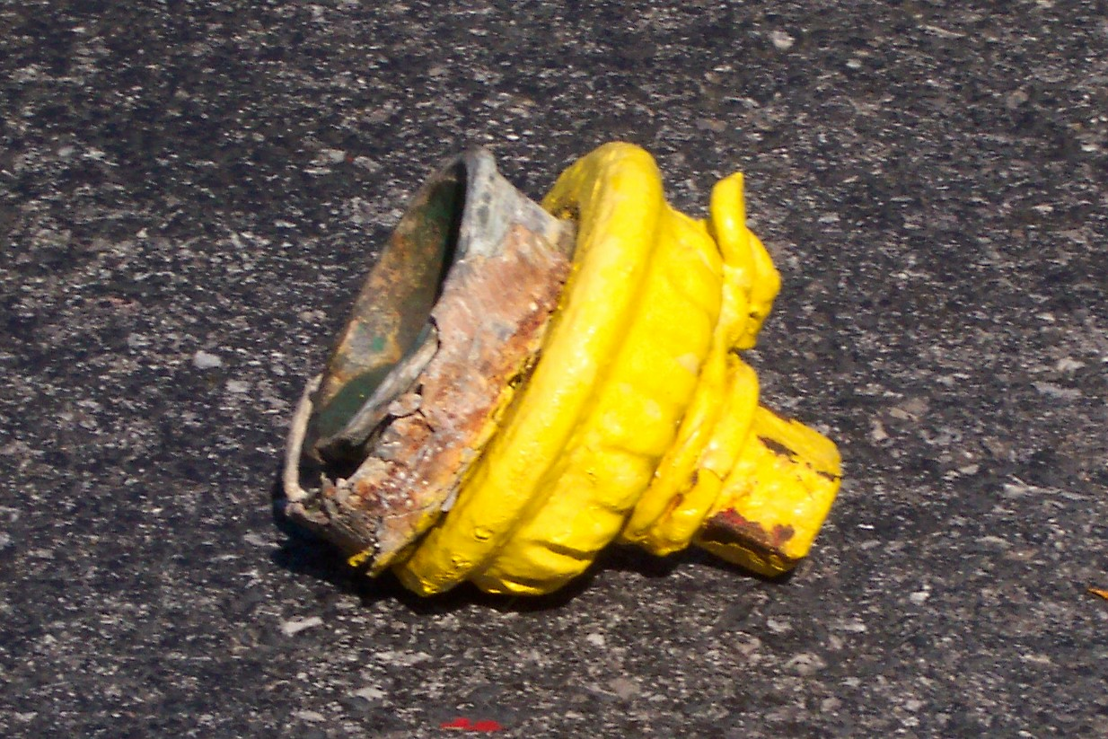
Basics: Such as standing BEHIND the hydrant when you open it can save your life!

Slide 4
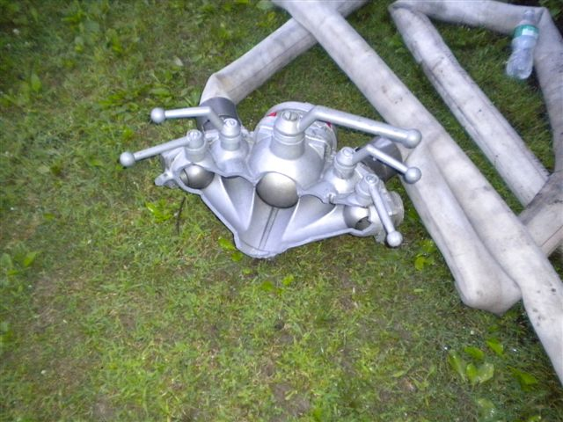
Any appliance or device can fail!

Slide 5
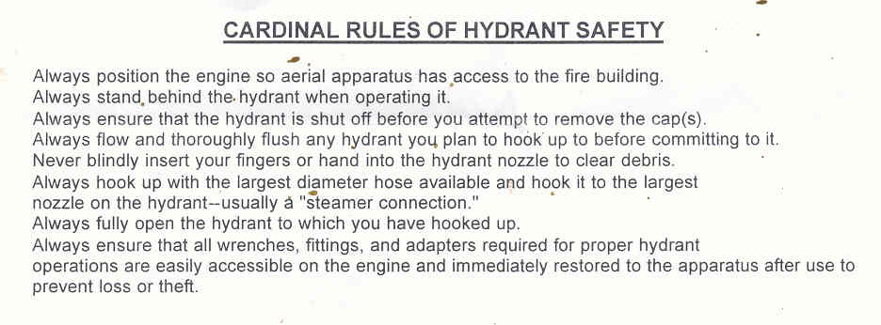

Slide 6
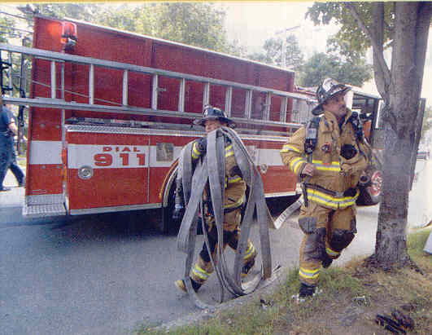
Will you have enough hose to get where you want to go?

Slide 7
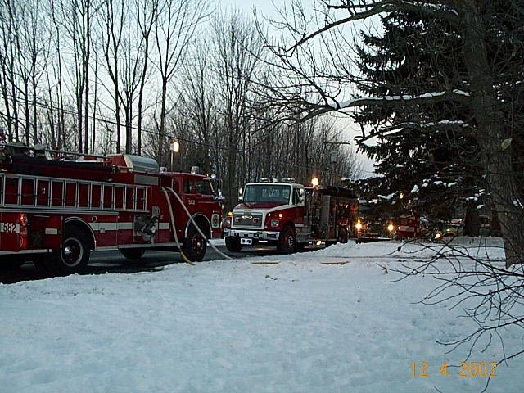
250’ 1 3/4 Pre-connected lines What do I have to pump to get approx. 100 GPM at tip, not stress the firefighter and conserve water?

Slide 8
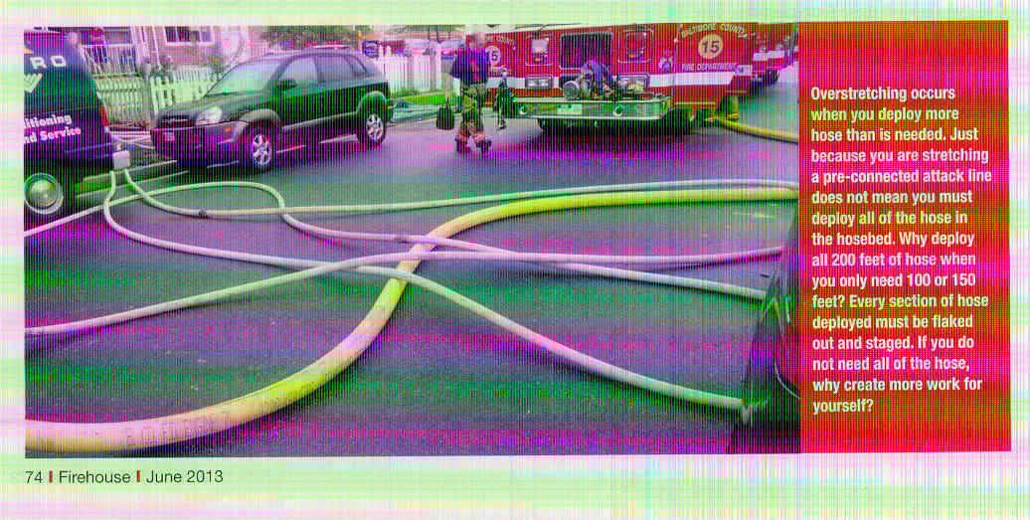
If you have 250 Ft. Pre-conned hose line and only need 150 Ft. what should you do?

Slide 9
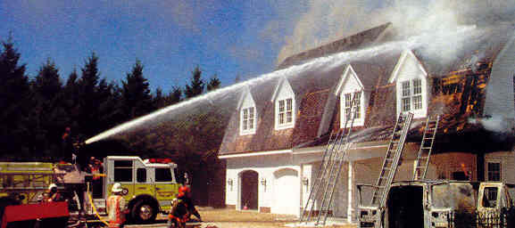
Consider master streams for knockdown 30 seconds you will used over ½ of your water in the tank!

Slide 10
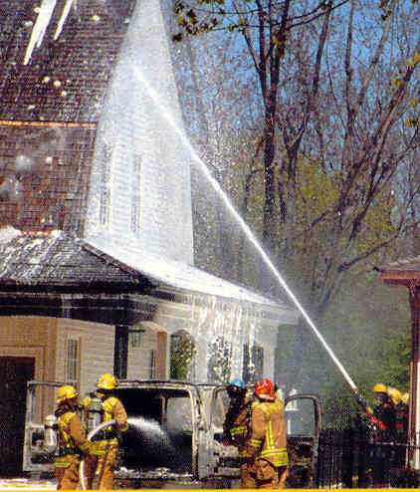
Hose Line Operation Considerations
What about class A foam?
Positive Pressure Ventilation?

Slide 11
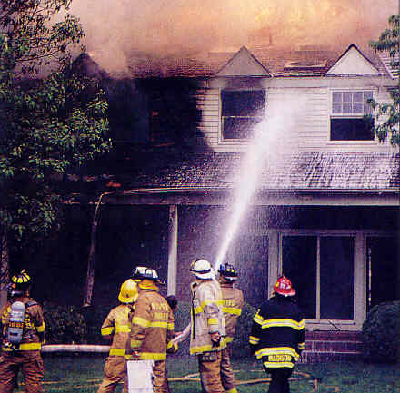
Water supply - Don’t waste it!

Slide 12
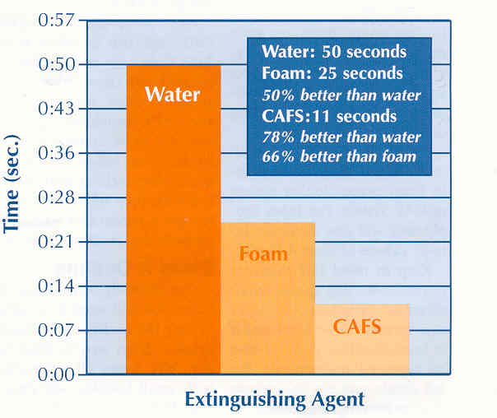

Slide 13
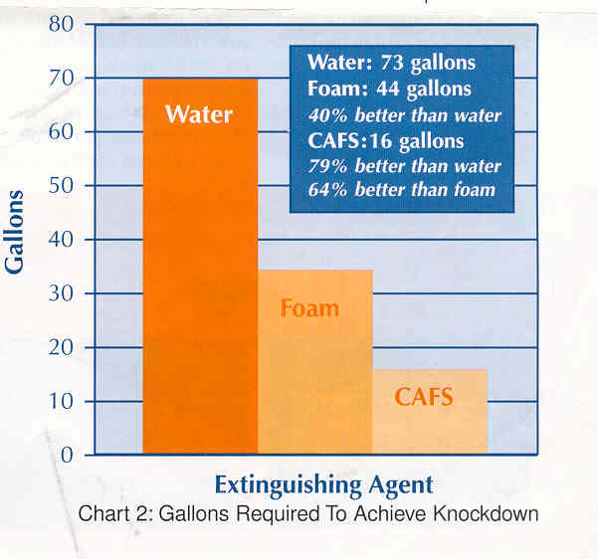

Slide 14
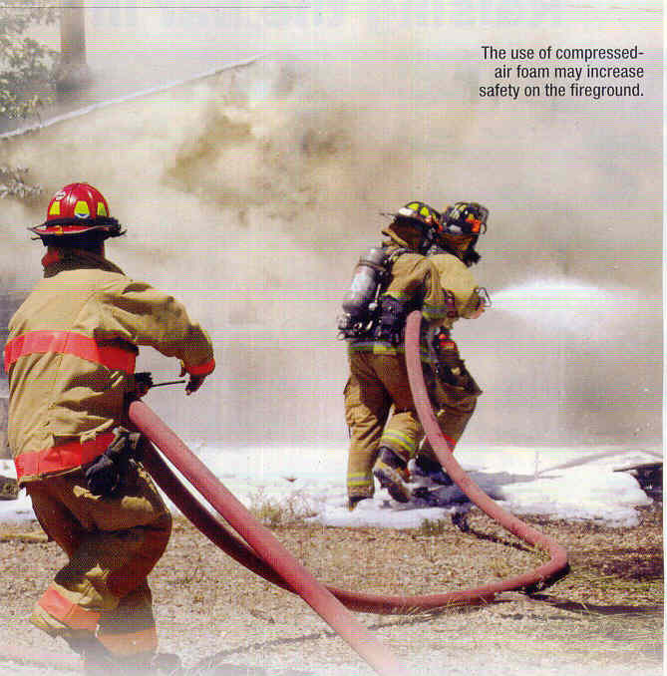
Class A Foam
Quicker knock down, less fatigue and stress on firefighters.
Using a lot less water.
Quicker overhaul and no rekindles.

Slide 15
Master Stream Operations
Water weighs approx. 8.3 lbs per gallon - 1000 GPM adds 8,000 lbs. of weight to the floor every minute. 2000 GPM = 16,000 lbs. 2000 GPM for 10 minutes = 160,000 lbs or 80 Tons!

Slide 16
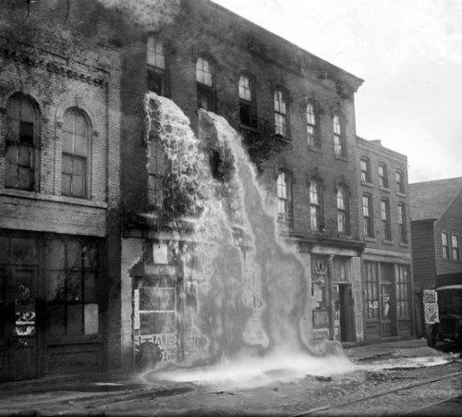
How you can tell if you have put enough water into a structure!

Slide 17
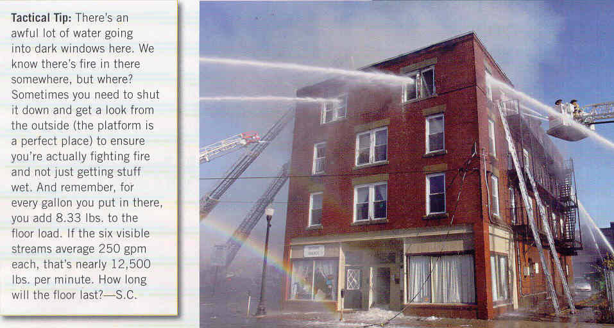

Slide 18
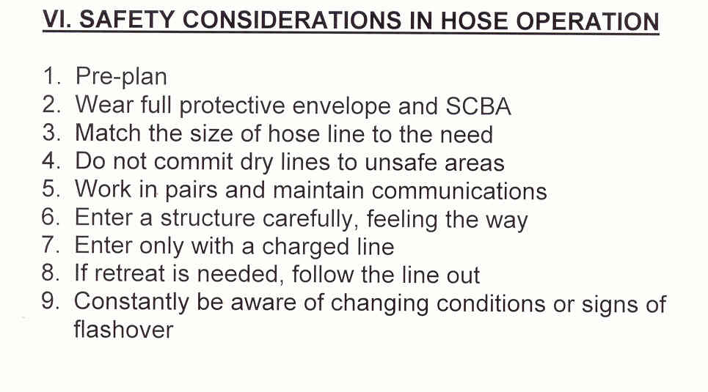

Slide 19
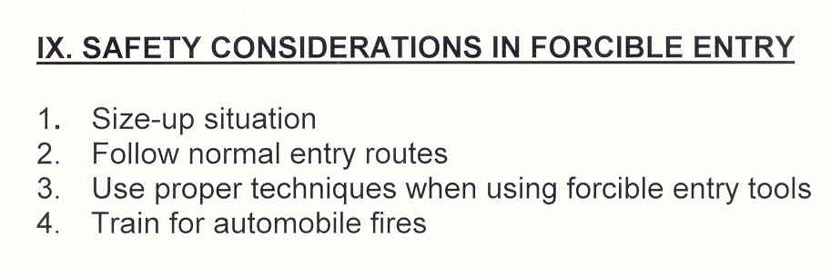
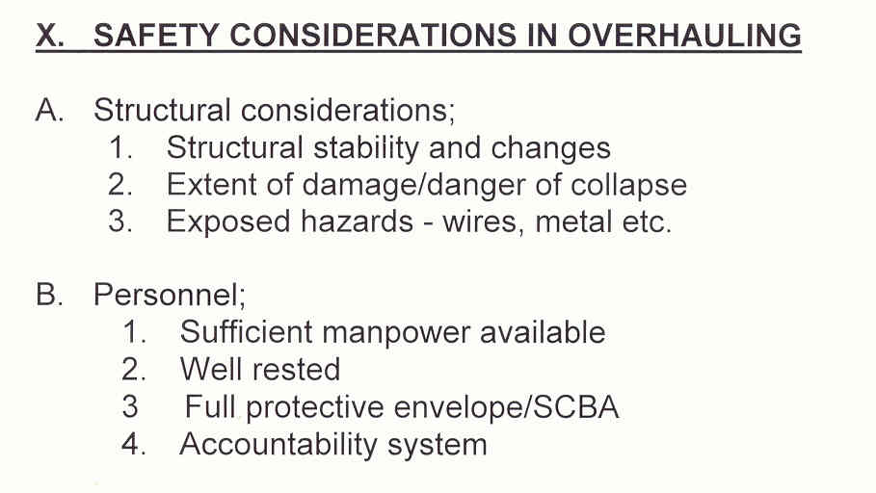

Slide 20
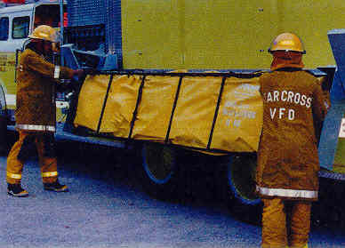
Portable ponds & tanker operations

Slide 21
