Slide 1
VEHICLE SITUATION SAFETY

Slide 2
Do a proper size up looking for all the hazards!

Slide 3
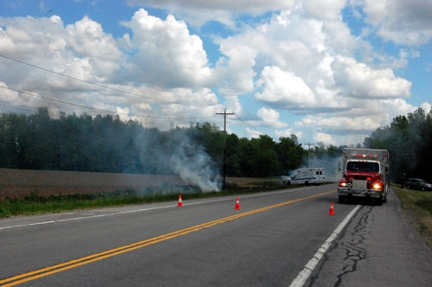
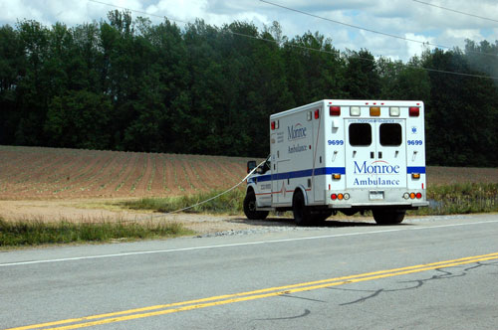
FD Responded to an MVA with report of car on fire – wires down – Ambulance parked down the street under the line when they snapped and fell on the ambulance

Slide 4
No time for "assessing", "evaluating" or "committee meeting", they did what should have been done and they did it!
ALBANY — When firefighters arrived, they saw a man's legs sticking out from beneath a Buick Rendezvous in a driveway. no time to call in heavy-duty specialty equipment to lift up the SUV. Six responders grabbed the front bumper, around the tire rim, anywhere they could get a hand-hold. On a count, they all heaved together. The front end of the 4,200-pound vehicle lifted slightly off Khokhar's chest for a split-second and pulled him free. They rushed the man to Albany Medical Center Hospital. The entire drama on Joanne Court lasted eight minutes.

Slide 5
What is new in 2014 with vehicles?
700 models now have side air-bags, some have compressed gas cylinders for the bags, many pickup have 110 volts (4- 42 volt batteries under the back seat) many have seat belt retractors.
What is being used as fuel? CNG (117 Octaine) propane, hybrid, diesel and add ons like nitrous oxide, some have 300 up to 700 volt power sources, !
New stronger materials (Boron steel) are being used in vehicles. 3 door pickup with stronger, larger latches and hinges. Dash post much stronger.
Gas or liquid filled cylinders replacing spring to hold up hoods and hatches.

Slide 6
How many vehicles have started on fire or blown up after you arrived on the scene of the incident? In my 26 years on the road as a trooper – NEVER. My 48 years in the FD – NEVER………. (Exception: some one messed with it) What is your experience?
AAA reports vehicles catch fire in 1 out of every 5,000 crashes. Vehicles blow up when involved in a crash 1 in 50,000 crashes.

Slide 7
Before you start cutting all the wires in the engine compartment and starting a fire or setting off the SRD (air bags) you better make sure you will not have to open windows, move the seat back, unlock doors ect.
The latest info on this is shut off and remove the key and leave the battery alone, especially when know one is in the vehicle.
Before you cut a car all to hell, try the door handle and see if the door will open. If possible have the occupant unlock the doors.
If you can get to the battery connections and it doesn’t interfere with anything else that is going on by all means DISCONNECT the positive wire.

Slide 8
What fuels the VEHICLE
Diesel, Gasoline, Cooking Oil, CNG, Hybrid, Hydrogen Generator Assist ?

Slide 9
Hydrogen Generator from the Internet $190.00 They make much bigger ones for large trucks!

Slide 10
Magnesium ? Water spray will put a very small amount out. It may take a few minutes but it will go out.

Slide 11
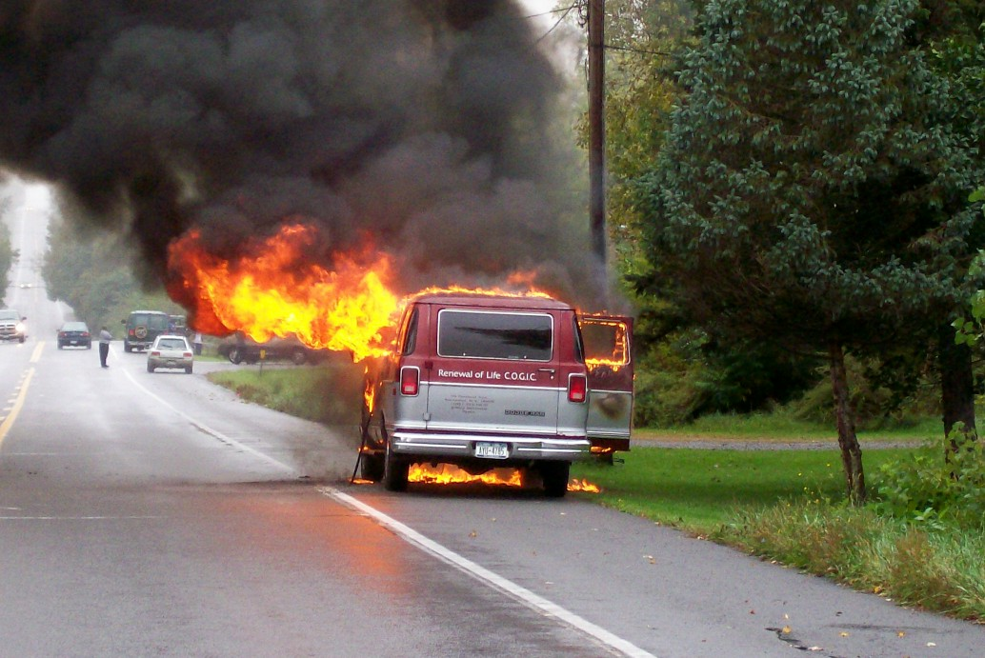
Attack Auto Fires from a 45 degree angle until it is knocked down

Slide 12
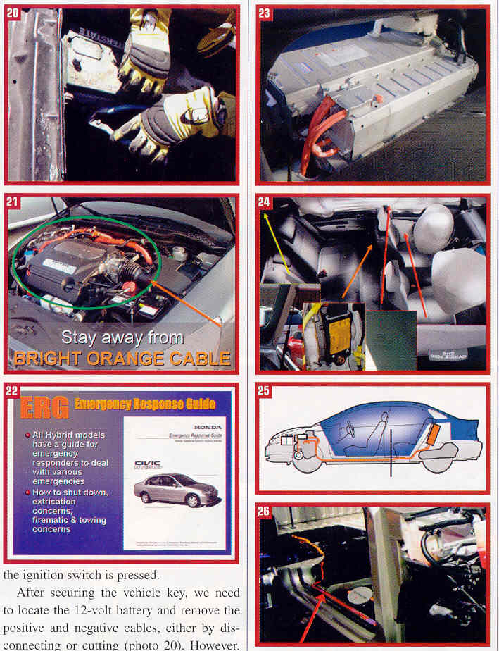
STAY AWAY FROM THE BRIGHT ORANGE CABLE

Slide 13
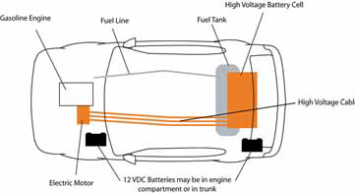
The HIGH VOLTAGE orange cables are 12 to 14 inches from the rocker panel

Slide 14
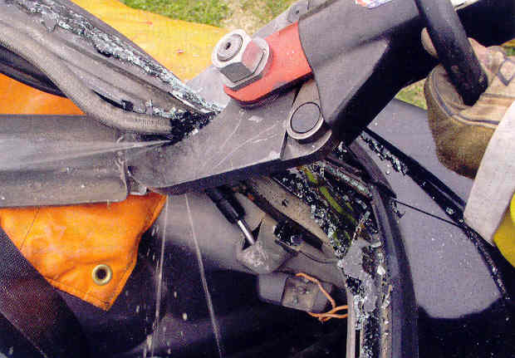
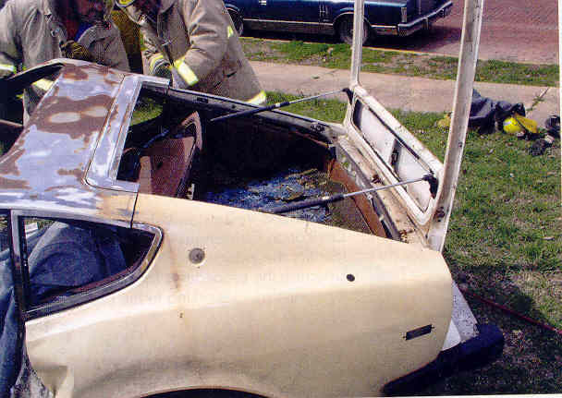
Pressurized Cylinders

Slide 15
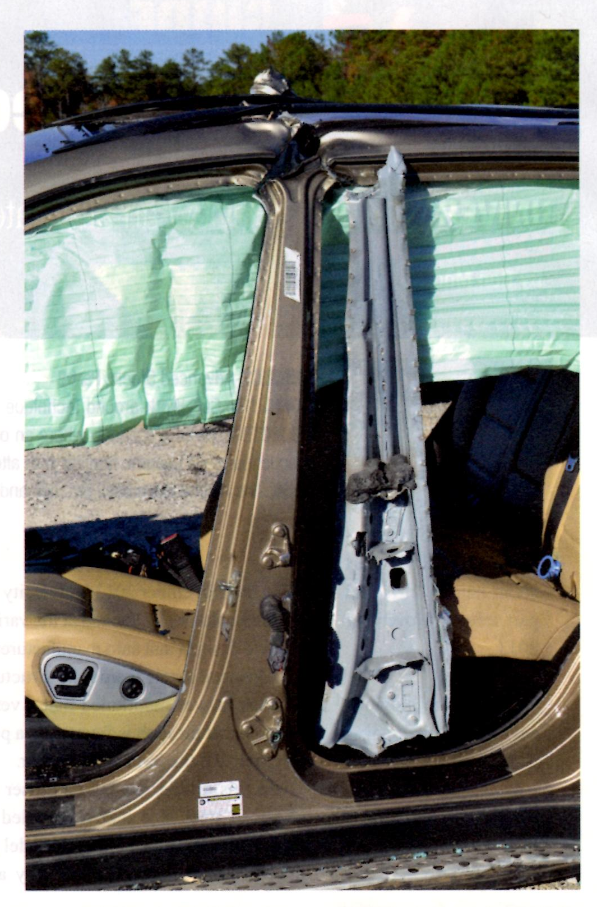
The new B post have a Boron pipe around the Boron Rod, lots of fun to try to cut through, BUT there is an easier way.

Slide 16
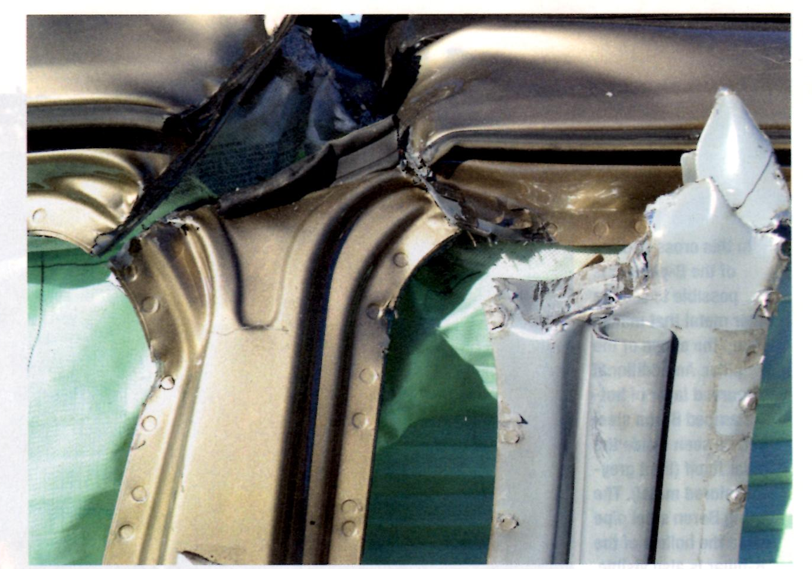
Make a “pie” cut above where the rod and pipe end

Slide 17
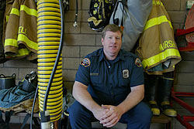
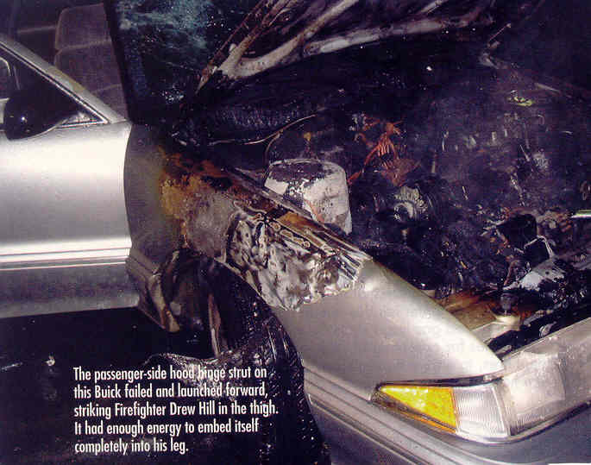
Gas filled strut went through his turnouts and leg!

Slide 18
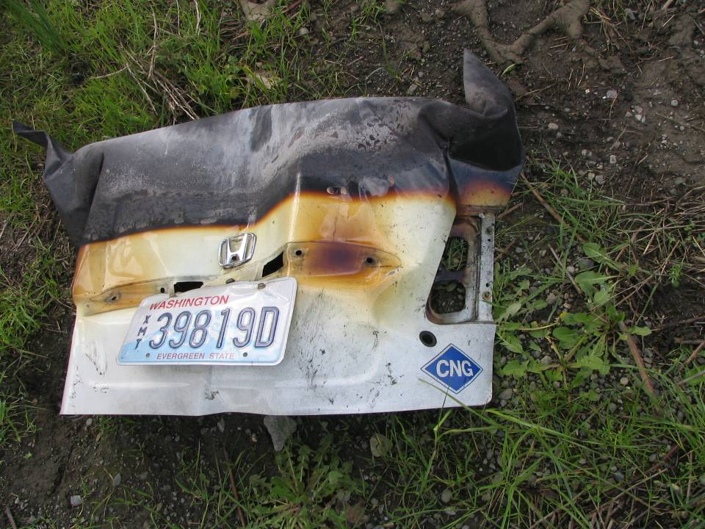
This is your only warning of
a CNG – fueled vehicle. Typically
located on the trunk lid or bumper

Slide 19
Lessons Learned /Best Practices
Approach from 45° angle to vehicle ends
Be aware of CNG vehicles
Cabs, city vehicles, shuttles
Look for CNG placards
Watch for other hazards, i.e. bumper struts; hood and tailgate struts; airbags; burning fuel runoff; hazardous vehicle contents; exploding tires; other traffic
Consider cooling streams from a distance

