Slide 1
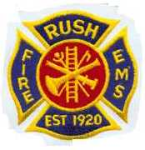
http://www.everyonegoeshome.com/media/2012/S7-3/player.html

Slide 2
Emergency Vehicle Response Operating Guidance
PURPOSE: (NFPA 1500, 6.2 and NYS-DOH – 00-13)
The emergency vehicle drivers must provide prompt conveyance of apparatus, equipment and personnel to render service to those in need in the safest and most prudent manner possible.
Emergency vehicle drivers have in their care, custody and control most of the major assets possessed by the organization.
Emergency vehicle drivers are held to a higher standard of care than the general motoring public and must provide due regard for the safety of others.
Safe arrival at the emergency scene shall be and must always remain the first priority of all emergency vehicle drivers.

Slide 3
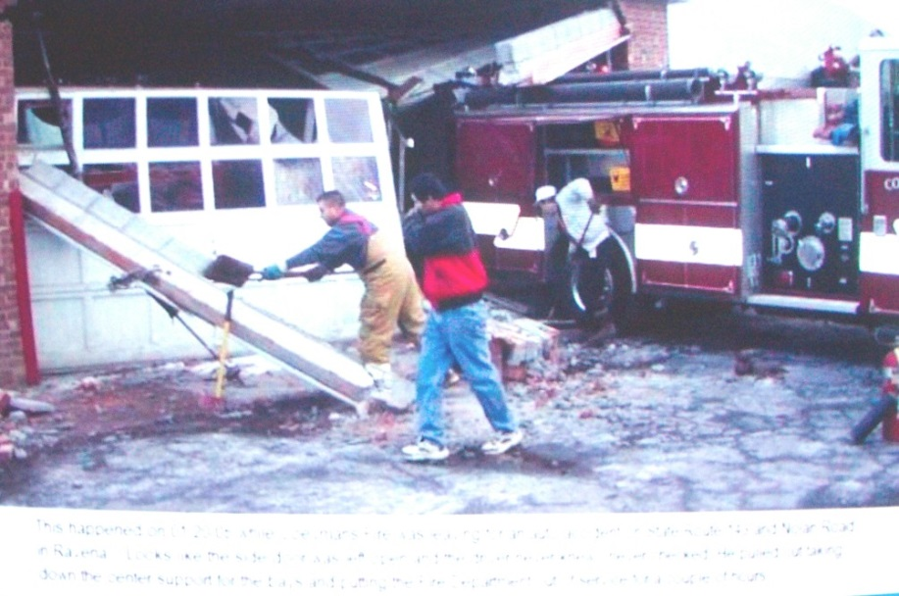
CHECKING VEHICLE PRIOR TO MOVING
Starting the vehicle then make a quick check around the vehicle to see that all equipment is secured, all compartment doors are securely closed and any physical obstructions are moved out of the way of the vehicle.
The driver should also verify clearance with the person riding in the officer position. All passengers shall fasten seat belts prior to vehicle movement!

Slide 4
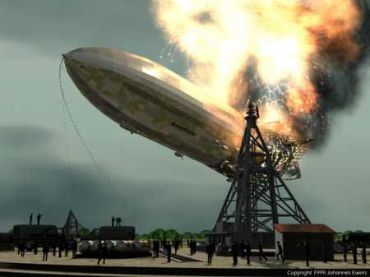
2. WARNING DEVICES AND TRUE EMERGENCIES
The definition of “True Emergency” (per USDOT, NYS OFP&C & New York States Department Of Health) is “any situation in which there is a high probability of death or serious injury to an individual or significant property loss, and actions by an emergency vehicle driver may reduce the seriousness of the situation”.
HOW MANY OF OUR CALLS FIT THIS DISCRIPTION?

Slide 5
When responding to a “True Emergency”, lights and siren will be operated. All emergency vehicle driver’s must understand that warning devices are not always effective in making other vehicle operators aware of your presence. Warning devices only request the right-of-way; they do not insure the right-of-way.
Upon arrival at the scene all vehicles will be parked in the safest location and in a position to carry out their function. If possible, locate them off the highway after checking to ascertain that the area will support the weight. The majority of the warning lights should be shut off and four way flashers activated. If on a highway park at a slight angle to the left or right depending on conditions. Be careful when using any flood or spotlights as not to blind on coming traffic.
Always watch the traffic. Never assume the on-coming traffic can see you or will do the right thing.

Slide 6
3. EMERGENCY - NON EMERGENCY RESPONSE
Upon arrival and size-up of an incident, command will advise all units as to the status of the incident. If no “true emergency” exists, command will advise equipment to respond in a non-emergency mode. Command may alter equipment response as necessary.
Response to automatic alarms without a back up call reporting a possible fire, mutual aid fill-ins, water problems, standbys, service calls, low batteries in smoke alarms, CO alarms with no medical emergency, lock outs and check and advise MVA’s other non-life threatening calls will be made in the non-emergency mode. During snow or ice conditions ALL responses will be non-emergency.
At any time RUSH vehicles are on the road, headlights should be on!

Slide 7
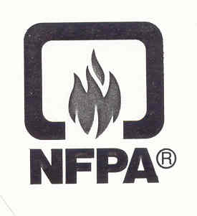
NFPA reports over 99.9% of ALL automatic alarms without a back up call will be a FALSE ALARM!
On the .1% of the calls where the FD is needed, 90% of the time one engine or unit will take care of the problem.
In the US fire departments responded to OVER 2.4 MILLION False alarms last year – that one every 11 seconds…….

Slide 8
4. VEHICLE CONTROL
All drivers shall maintain control of the vehicle to provide the maximum level of safety for both their passengers and the general public.
Civilian vehicle operators might not react in the manner, which is expected or appropriate.
You should have options available when passing or overtaking vehicles.
Be aware of the rate of closure on other vehicles and pedestrians at all times.
A safe following distance of 4 or 5 seconds of following distance shall be maintained.

Slide 9
5. RESPONSE SPEEDS:
While operating district owned equipment drivers will not exceed the posted speed limit. The ambulance may be operated 10 miles per hour over the posted speed limit, conditions permitting. Examples of conditions requiring slower response speeds include but are not limited to:
Slippery roads
Inclement weather
Poor visibility
Heavy or congested traffic conditions
Sharp curves

Slide 10
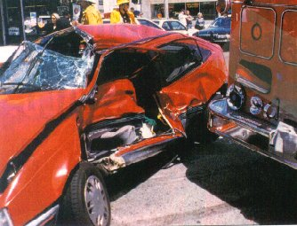
INTERSECTION PRACTICES
Extreme care should be taken when approaching any intersection, as intersections are the locations responsible for a large percentage of major accidents involving emergency vehicles. Drivers are required to practice the following intersection operating guidelines during all emergency responses:
60% of ALL EV crashes when running red take place in an intersection. 90% of the Lawsuits from EV crashes are from intersection crashes. 90% EV drivers in prison had their crash in an intersection…

Slide 11
UNCONTROLLED INTERSECTIONS
Intersections that do not offer a traffic control device (signal, yield or stop sign) in the direction of travel of the emergency vehicle or where the signal light is green should be approached in he following manner.
1. Scan the intersection for all possible hazards, right turns on red, pedestrians, fast approaching vehicles, bicycles, etc.
2. Check traffic in all four directions in the area of the intersection.
3. If you have the green light do not exceed the posted speed limit.
4. As you approach the intersection remove your foot from the accelerator and place it over the brake pedal. BE READY TO STOP.
5. Activate siren in wail mode at least 250 feet prior to the intersection and, if so equipped, sound air horns a few short blasts if there is any type of hazard in the area of the intersection.
6. Pass other vehicles on the left whenever possible. If you pass on the right use extreme caution. 7. Always be prepared and keep the vehicle speed low enough so you can stop if another vehicle fails to yield the right-of-way.
Remember - You only have the right-of-way if someone yields it to you. If they don’t yield, you don’t have the right-of-way.

Slide 12
CONTROLLED INTERSECTIONS
Intersections controlled by a red traffic light, flashing red light, stop sign or a yield sign require a complete stop by the emergency vehicle operator. The following will also make your trip safer at the controlled intersection:
1. Do NOT rely on the warning lights, sirens or air horns to clear traffic.
2. Scan the intersection for all hazards and travel options as you approach. Pass on the left whenever possible.
3. Slow the vehicle well in advance off the intersection. Downshift. Apply the brakes slowly. Continue to scan all areas of the intersection.
4. COME TO A COMPLETE STOP and continue forward only after you are sure you have control of EVERY LANE of the intersection.
5. Communicate your intention to move forward and try to have eye contact with the other drivers in the intersection if possible.
6. Every lane of an intersection must be treated as separate intersection.
7. Activate siren in wail mode at least 250 feet prior to the intersection and, if so equipped, sound air horns a few short blasts if there is any type of hazard in the area of the intersection.
8. Be alert for other emergency vehicles or drivers that may not see or hear you.

Slide 13
RAILROAD INTERSECTIONS
National Fire Protection Organization (NFPA) Operation Lifesaver and the Federal Highway Transportation Safety Administration (FHWTSA) say emergency vehicles must come to a COMPLETE STOP at every unguarded crossing before going across. The following is also recommended.
UNGUARDED CROSSING
1. Shut down the siren(s), air horn(s) and any other sound producing devices.
2. Do not race the engine; let it run at idle speed.
3. Open window and listen for the train’s horn(s) or bell(s).
GUARDED CROSSING
1. Slow down and be ready to stop for a train. The crossing safety warning equipment may not be working.
2. Never try to beat the gates or proceed when the warning lights are on.
3. Never drive around the gates because the train has passed and you think the gates are going up too slowly.
STOP, LOOK, LISTEN and LIVE!

Slide 14
PASSING EMERGENCY VEHICLES
You should never attempt to pass another emergency vehicle (EV) that is on an emergency response. The only exception is when the other EV has a problem and its operator clearly signals you to pass. Even then, extreme caution must be used.

Slide 15
CONVOYS AND ESCORTS
The disadvantages of EV convoys and escorts greatly outweigh any advantages. If two or more Emergency Vehicles are going to a scene they should stay at least 500 feet apart. Cars that pull over may pull back directly into the path of the second vehicle if not enough distance is maintained. Using a “wail” mode in the first vehicle and a “yelp” mode in the second vehicle may also help to prevent such accidents.

Slide 16
STOPPED SCHOOL BUSES
Emergency Vehicles are not exempt from the stopped school bus laws. Never pass a stopped school bus that is displaying red lights. If the driver shuts off the lights and signals you to pass, then - and only then - should you move forward. Be very careful, children can be unpredictable.

Slide 17
PASSING VEHICLES AS YOU RESPOND
If possible, you should pass vehicles on the left. Most people do not expect to be passed on the right, especially by an emergency vehicle. Most states require that other vehicles yield to the emergency vehicle by going to the right and then stopping. If another vehicle decides to move to the right as you try to pass on the right, you’re in trouble. Only in rare situations can passing on the right using extreme caution be justified.

Slide 18
CROSSING THE CENTER LINE
Crossing the centerlines of a highway should be done only if the lanes in front of you are completely blocked and you have no other choice. Use extreme caution. On a two-lane road, the double yellow or single yellow line on your side should never be crossed.

Slide 19
EXPRESSWAY and THRUWAY OPERATIONS
ROUTE I-390 RESPONSE:
Firefighters shall refrain from taking private vehicles onto I-390. Private vehicles should be parked on the side of the road and the fire equipment will pickup members at exit 11. If the equipment is on I-390 before you can get to exit 11, respond to your assigned station and stand by.
On expressways and thruways, the flow of traffic is a priority. The flow must be maintained or serious rear-end accidents may occur. In most cases, traffic flow can be maintained. If traffic must be stopped, a warning must be placed prior to the backup. Vehicles should be parked only on one side of the highway, at a slight angle with wheels turned toward the shoulder. Cones should be used to move traffic where you want it to go. Shut down ALL forward facing emergency lights. (4-ways OK) Never stand between the flow of traffic and the rear of any vehicles stopped at the incident. If you have to make a U-turn, do it at the area maintained for U-turns.

Slide 20
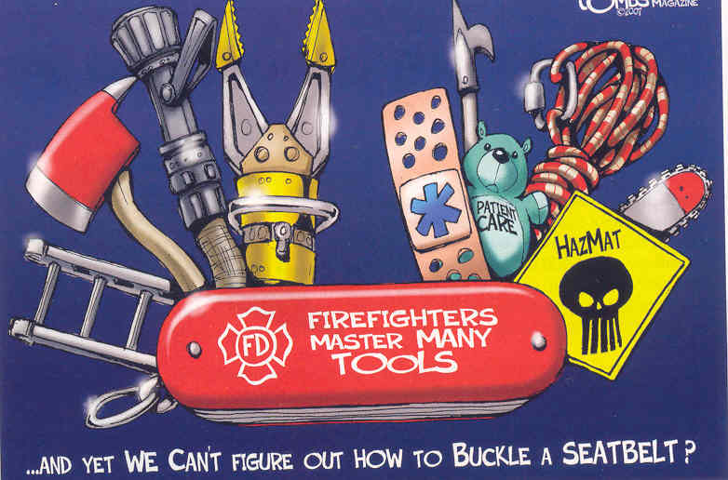
Seat Belts
National Fire Administration (NFA) 10 year study showed: Of the firefighters killed in crashes, 27% were ejected from the vehicle. 70% of F/F killed in crashes in the last TEN years had NO BELT ON!

Slide 21
RIDING POLICY and SEAT BELTS
The District requires all persons riding on emergency apparatus to be seated in approved riding positions and be secured ion the vehicle by seat belts prior to the vehicle being placed into motion. Use of Passenger Restraint devices are required by NFPA and NYSDOH.
The emergency vehicle operator or the person riding in the officer position shall verify that all personnel are properly seated and in seat belts before the vehicle is moved.
Personnel who perform emergency medical care while the vehicle is in motion should be secured to the seat by a seat belt whenever possible.

Slide 22
BACKING
The District requires that whenever possible drivers should avoid backing, as the safest way to back up a vehicle is not to back up at all. When it is necessary to back up any emergency vehicle, all drivers shall adhere to one of the two following guidelines.
The Districts procedure is that before any vehicle is put into reverse and backed up, that a spotter be placed near the left rear of the vehicle. The spotter should be positioned so that the driver can see the spotter at all times. If at any time the driver loses sight of the spotter, he / she shall immediately until the spotter becomes visible again. The spotter shall observe the area immediately behind and above the vehicle.
If conditions exist that make use of a spotter impossible or impractical, all drivers shall get out and check behind and above the vehicle before backing to insure that there is nothing in the path of vehicle travel.

Slide 23
RESPONSE IN A PRIVATELY OWNED VEHICLE (POV)
When responding to the station or scene of an emergency in a privately owned vehicle (non-district or department vehicle), all applicable motor vehicle laws shall be strictly adhered to. Privately owned vehicles are not granted any exemptions to the vehicle and traffic laws that apply to authorized emergency vehicles. Private vehicles are not emergency vehicles and therefore are not afforded any exemptions or special privileges under state law.
Due to the stress that a timely response generates, you must make a special effort to operate a vehicle in a safe manner. As with emergency vehicles, you should pay close attention to:
1. Speed limits, road, weather and light conditions.
2. Intersections with or without a traffic control device.
3. Passing and Turning.

Slide 24
You may be held both civil and criminally liable if an accident were to occur while on duty as an emergency responder. The agency for whom you work can also be brought into a lawsuit if the case can be made that you were improperly or inadequately instructed, or no effort was made to control unsafe or reckless operation when responding.
When parking at a scene, keep all vehicles as far away as possible and in a safe position. Attempt to keep all vehicles on one side of the road and out of the street if possible. Park at a slight angle with wheels turned toward the shoulder.

Slide 25
ALCOHOLIC BEVERAGES – DRUGS & FATIGUE
Under no condition shall a firefighter respond to any alarm if that firefighter has even the smell of alcohol on their breath or is under the influence of any type of intoxicant or drug.
Firefighters should also refrain from driving if they are tired or under any emotional stress that could effect their driving in a safe and alert manner.

Slide 26
BASIC DEFENSIVE DRIVING:
Use your eye properly - look 20 to 30 seconds ahead.
Drive with your headlights on at all times.
No cell phone use or texting while moving.
ALWAYS wear your seat belt.
Reduce your speed when conditions are not 100%.
Keep a ”margin of safety” and stay out of blind spots
Signal your intentions early.
Cover the brake when things don’t look right.
Never drive when tired, angry or under any influence of drugs or booze.
Always be looking for an escape route.

Slide 27
OTHER OPERATOR DUTIES
The driver will allow only RUSH firefighters and explorers to remove any tools or equipment from the apparatus.
Drivers will not leave the area of the vehicle they drove to the incident.
Drivers will return vehicles to the fire station only upon orders of the incident commander.
Drivers are responsible to fill out the log book, make sure the vehicle water and fuel tanks are full and restock any items that were used including SCBA’s.
When operating from a district or personal vehicle while at the NYS School at Industry or any juvenile or adult correctional facility, the vehicle shall be locked unless manned.

Slide 28
ACCIDENT PROCEDURES
If involved in a motor vehicle accident, the operator or officer shall advise the incident commander via a non-dispatch channel. Check for and treat any injuries and secure the scene. The operator must remain at the scene of the accident.
The operator and crew will make no statements to anyone except police, Rush Fire Department command officers and / or commissioners of the fire district.

Slide 29
MISCELLANEOUS INFORMATION
Fire District vehicles shall be operated by members who have successfully completed an approved driver training program or who are under the direct supervision of a qualified driver or driver trainer.
Drivers will have a working knowledge of the apparatus and the equipment carried on it.
Officers will refrain from driving equipment if possible.
When the operator is under the direct supervision of an officer that officer, will also assume responsibility for the safe operation of the vehicle.
Chief Officers and Fire Police are the only members that may pass any fire district apparatus while en-route to a call. They can only pass when the emergency vehicle operator is made aware by radio or other means that another vehicle is going to pass them.

