Slide 1
Small Tools & RIT Team

Slide 3
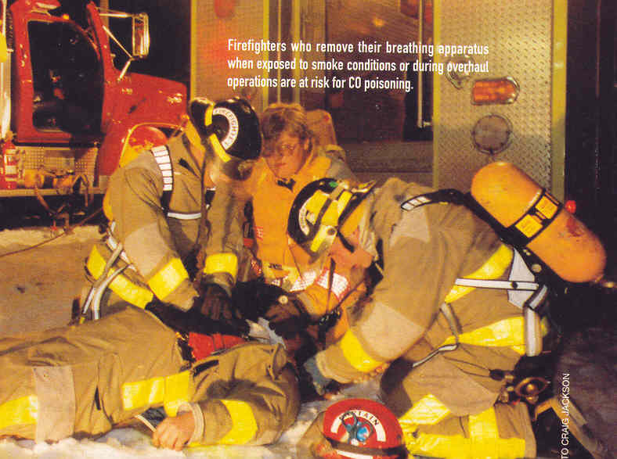

Slide 4
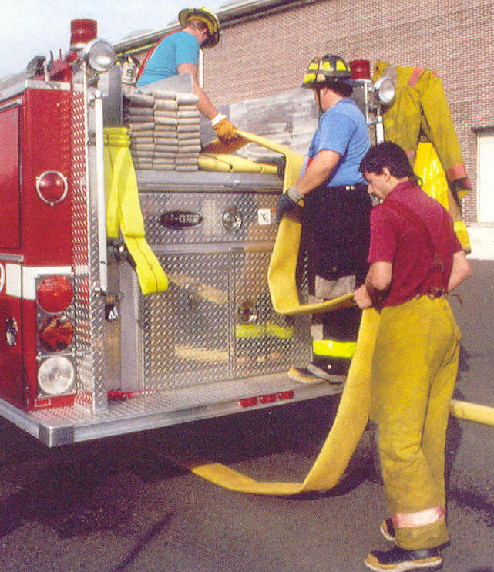
Loading any style hose should be done by moving forward, not backing up!

Slide 5
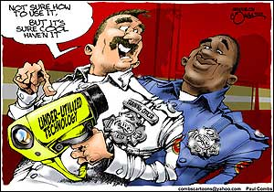
New Gadgets WILL NOT solve your problems!

Slide 6
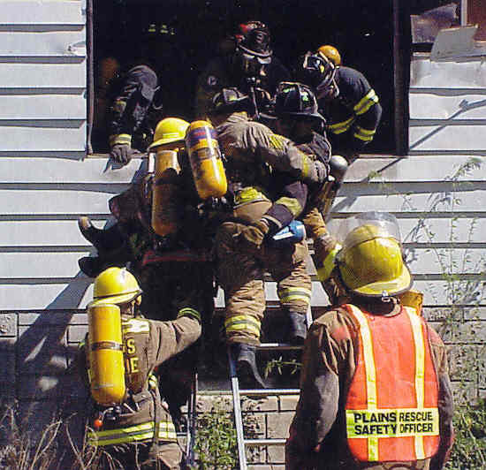
FAST or RIT TEAMS

Slide 7
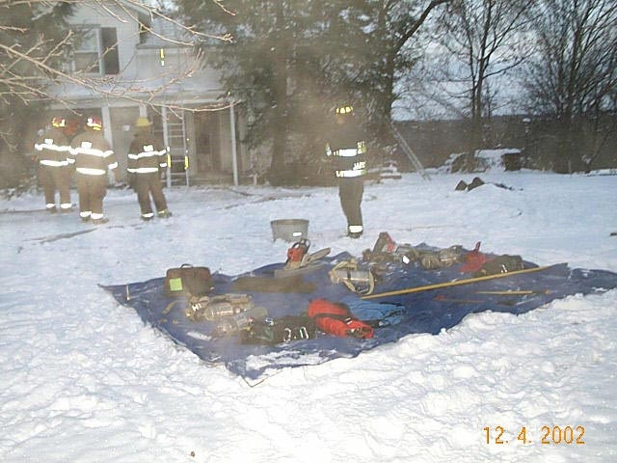
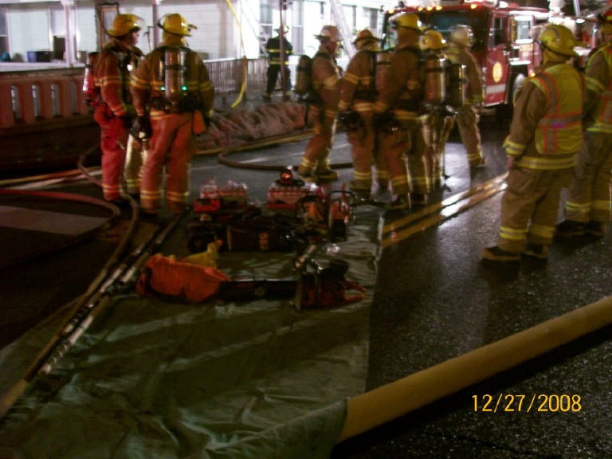
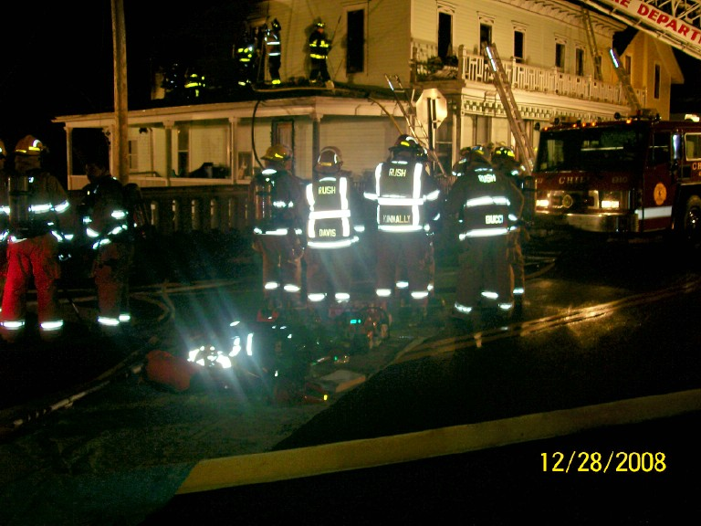
RIT/FAST Equipment Staging Area

Slide 9
Small tools and equipment safety
Use the tool for the job it was designed to do
Read the owners manual BEFORE you use the tool
Practice with the tool BEFORE you have to use it during and emergency situation.
DO NOT remove any guards or safety devices
DO NOT disable any safety devices on the tool
Clean the tool before you put it back on the rig
Report any problem s with the tool to a supervisor
NEVER put a broken or out of service tool back on the truck.

Slide 10
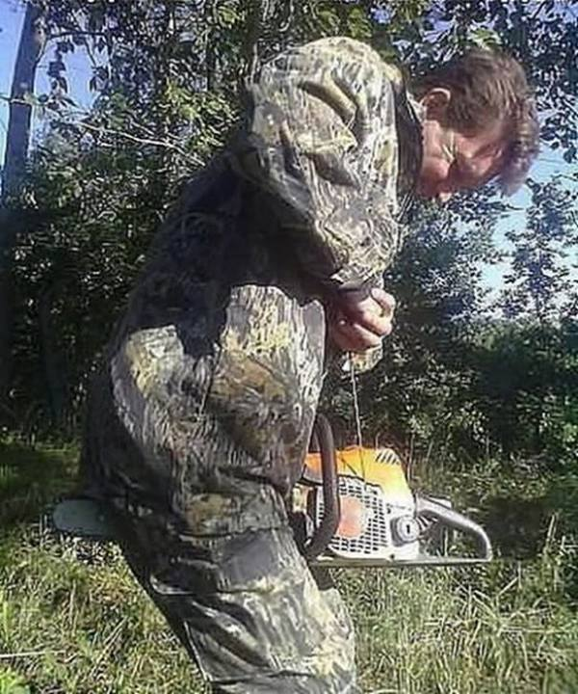
No, No, No,

Slide 11
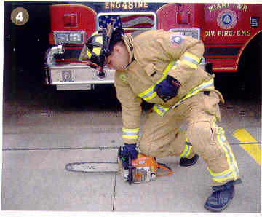
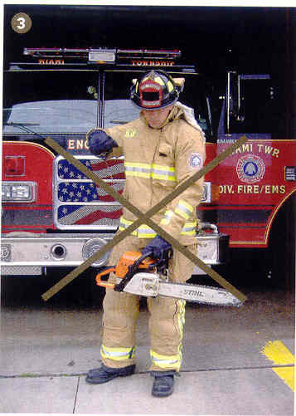
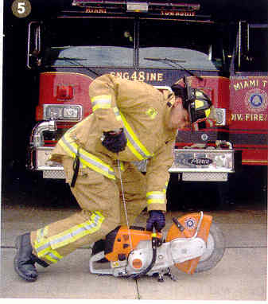
The correct way to start the tool

Slide 12
The following are nine key components of rehab required under NFPA 1584: · Relief from climactic conditions; · Rest and recovery; · Cooling or re-warming; · Re-hydration; · Calorie and electrolyte replacement; · Medical monitoring; · EMS treatment in accordance with local protocol; · Member accountability; and · Release from rehab.

